Slide 1



TEXT SUMMARIZATION USING NLP
Project Mentors:
Mr.K.Narendra &
Mr.Nishant

Slide 2



OUR TEAM- GROUP 3
VODNALA SRUJANA
PRABHJOT SINGH
ANURAG DVS
PREETI PANJWANI
Let's begin...
😊
Oversee project progress & documentation and report compilation
Data preprocessing & evaluation, building interface
Model implementation & deployment
PPT presentation-helped the team lead
ROLES PLAYED

Slide 3
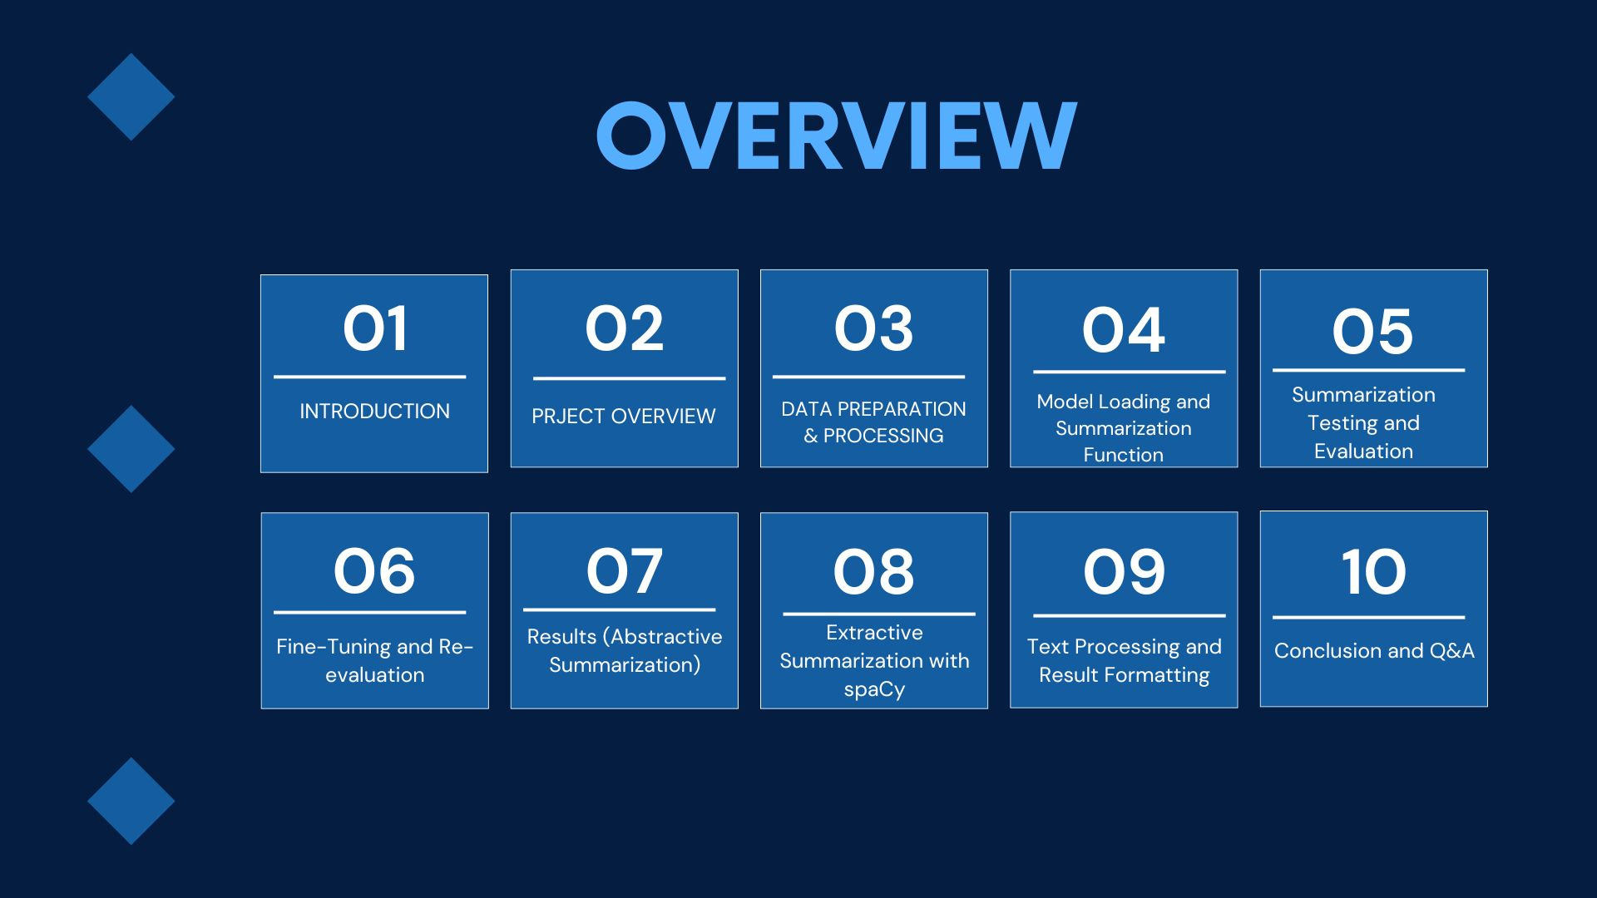
AGENDA:

Slide 4

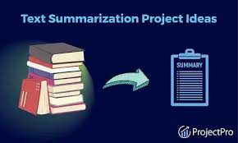

INTRODUCTION
Text Summarization using NLP
Text summarization is a powerful natural language processing (NLP) technique that aims to extract the most important and relevant information from a given text. By using advanced machine learning models, we can generate concise yet informative summaries that capture the key points and insights.
.

Slide 5

Workflow
Data Preparation
-Load necessary libraries
- Load Samsum dataset
- Tokenize text
- Prepare input articles and summaries for T5 model
- Load pre-trained T5 model
- Define summarization function
- Generate summaries using conditional generation
Model Loading
Summarization Testing
-Test function on sample articles
- Compare generated summaries with originals
- Evaluate using ROUGE metric
Customize model with Trainer class
- Fine-tune for specific task or dataset
- Evaluate performance using ROUGE
Fine-Tuning
Results and Integration
-Evaluate abstractive summarization results
- Integrate extractive summarization using spaCy
- Generate final summaries and format results

Slide 6





PROJECT OVERVIEW
Developing a text summarization model using T5 and spaCy, performing both abstractive and extractive summarization, to generate accurate and concise summaries from original text, demonstrating the models' proficiency in NLP.
01
This project employs both abstractive and extractive summarization techniques.
02
Abstractive summarization uses the T5 model to generate concise summaries, creating new sentences that capture the original text's essence.
03
In contrast, extractive summarization with spaCy selects and combines existing sentences from the original text to form a summary, highlighting key points and preserving original content.

Slide 7

ABSTRACTIVE SUMMARIZATION
DATA PREPARATION AND PREPROCESSING
- Importance: Ensures quality and relevance of data for model training
- Steps:
- Data Collection: Gathering text data from various sources
- Data Cleaning: Removing noise, punctuation, and special characters
- Tokenization: Splitting text into individual words or tokens
- Stopword Removal: Eliminating common words like "the", "and", etc.
- Stemming/Lemmatization: Reducing words to their base form
- Vectorization: Converting text into numerical representations
- Tools/Libraries: NLTK, spaCy, Pandas, NumPy
- Output: Preprocessed data ready for model training

Slide 8
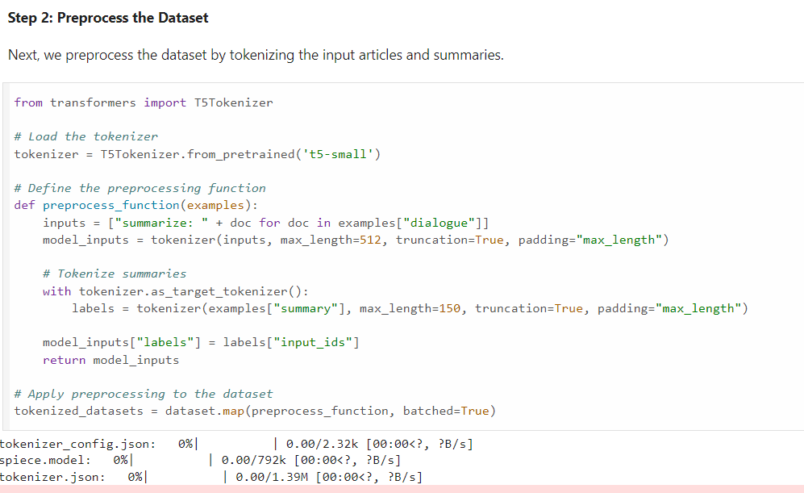
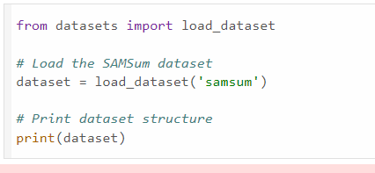
DATA PREPARATION AND PREPROCESSING RESULTS
ABSTRACTIVE PART

Slide 9


MODEL LOADING AND SUMMARIZATION FUNCTION
- Model Loading: This step involves loading a pre-trained T5 model, which is a type of text-to-text transformer model. The T5 model is trained on a vast amount of text data and can generate text, answer questions, and summarize content.
- Conditional Generation: This refers to the process of generating text based on a specific condition or input. In this case, the input is the text that needs to be summarized.
- Defining the Function: This involves creating a programmatic function that utilizes the loaded T5 model to generate summaries. The function takes in the text to be summarized and outputs a concise summary.

Slide 10
SUMMARIZATION TESTING AND EVALUATION
- Testing the function on sample articles: This involves feeding a set of sample articles into the summarization function to generate summaries. This helps to assess the model's performance on a variety of texts.
- Comparison of generated summaries with the originals: This step involves comparing the generated summaries with the original articles to evaluate their accuracy, relevance, and overall quality.
- Using the ROUGE metric for evaluation: ROUGE (Recall-Oriented Understudy for Gisting Evaluation) is a widely used metric for evaluating the quality of machine-generated summaries. It measures overlap between generated summaries and original texts, assessing their similarity.

Slide 11

FINE-TUNING AND RE-EVALUATION
- Customizing the model with the Trainer class: This involves using the Trainer class to fine-tune the pre-trained T5 model on a specific dataset or task, adapting the model to the particular requirements and characteristics of the data.
- Importance of fine-tuning for specific tasks or datasets: Fine-tuning allows the model to learn task-specific features and improve performance on the target dataset, leading to better results and more accurate summaries.
- Post-augmentation performance evaluation using ROUGE: After fine-tuning, the model is evaluated again using the ROUGE metric to assess its performance on the summarization task, comparing the generated summaries with the original texts.

Slide 12

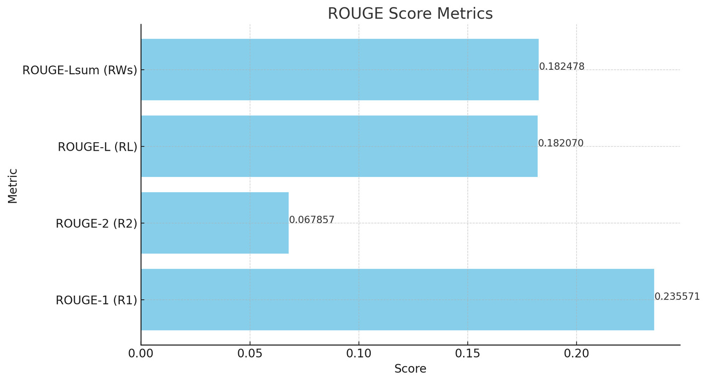
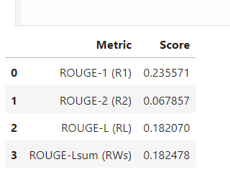
Rouge Analysis:
Before fine-tuning

Slide 13
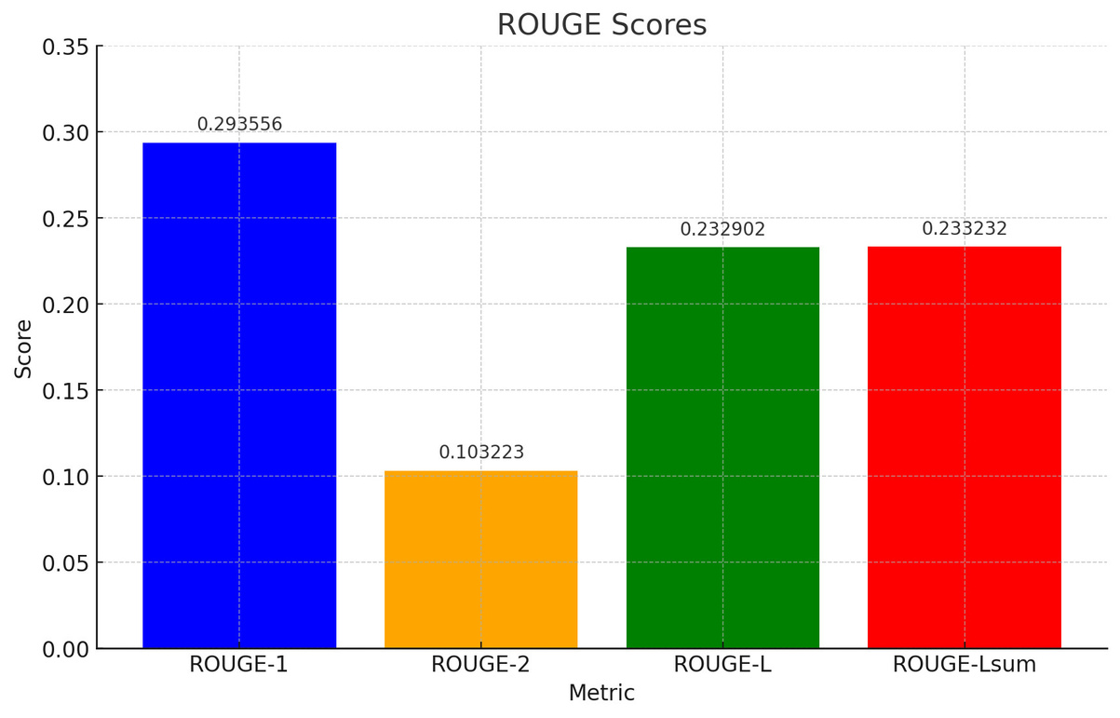
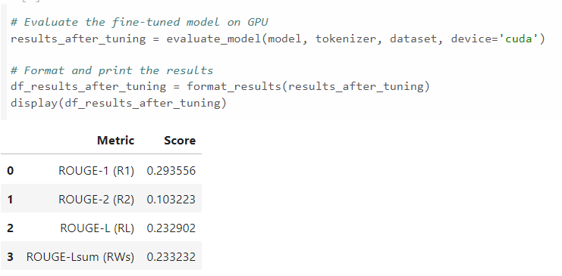
Rouge Analysis:
After fine-tuning

Slide 14
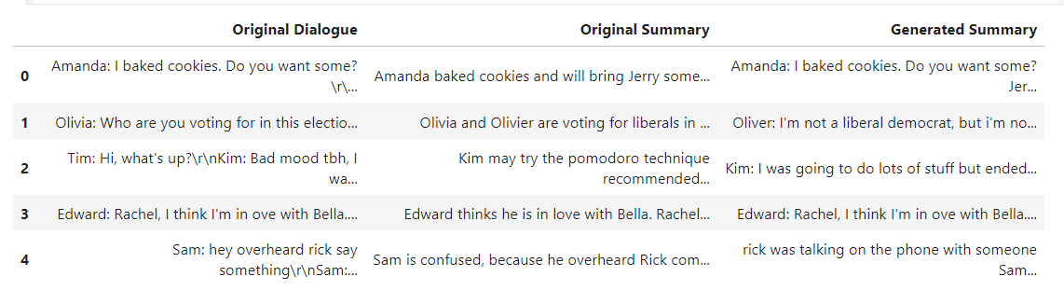
RESULTS (ABSTRACTIVE SUMMARIZATION)
- Evaluation Metrics: ROUGE scores, Precision, Recall, F1-score
- T5 Model Performance:
- Proficient in generating accurate and relevant summaries
- Effective in capturing key points and nuances

Slide 15
EXTRACTIVE SUMMARIZATION WITH SPACY
Overview: Extractive summarization selects important sentences directly from the original text.
spaCy Library: Robust NLP library used for tokenization, sentence parsing, and entity recognition.
Dependency Installation: Install spaCy and tabulate libraries for text processing and result formatting.
English Language Model: Download spaCy's English language model for accurate text processing.

Slide 16
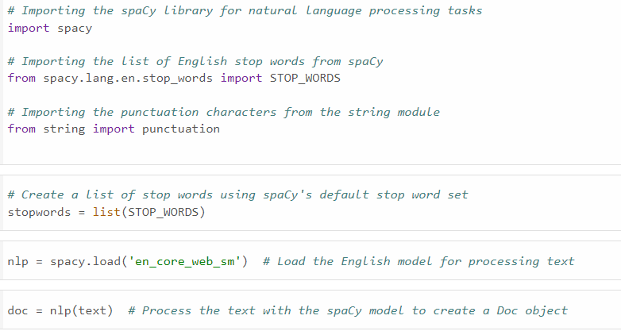
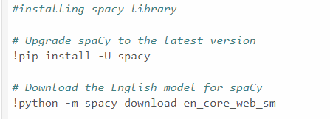
EXTRACTIVE SUMMARIZATION
DATA PREPROCESSING RESULTS

Slide 17
SENTENCE SCORING &
SUMMARY GENERATION
Sentence Scoring:
Score sentences based on their word frequencies to determine importance.
Summary Generation:
Select top-ranked sentences to form the extractive summary.
Example of extractive summary generation demonstrating the process.
Result Formatting:
Structure the summary and original text using tabulate for clear presentation.
Save the extractive summary model as a pkl file for easy integration into applications.

Slide 18
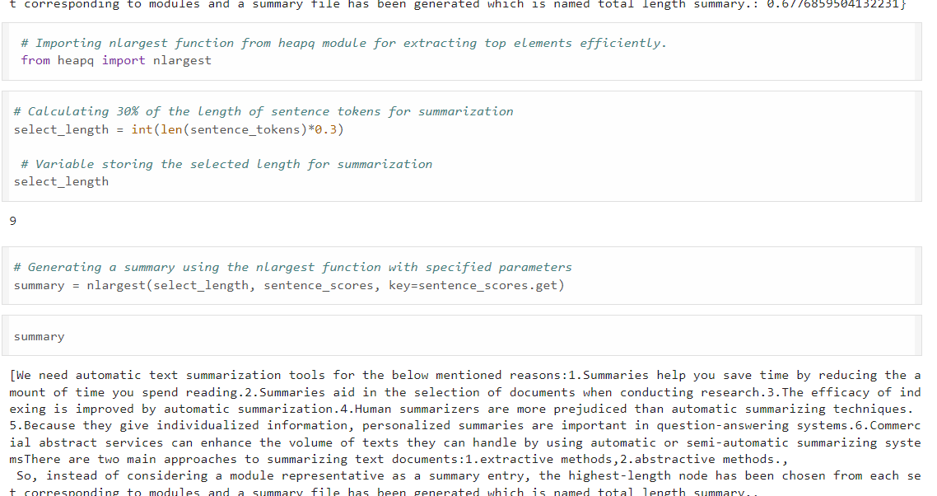
Result of Extractive Summarization

Slide 19






Challenges Faced:
Data Complexity: Handling diverse datasets and ensuring uniform preprocessing.
Model Complexity: Tuning hyperparameters for optimal performance of T5 and spaCy models.
Evaluation: Interpreting ROUGE scores and balancing between abstractive and extractive summarization quality.
Lessons Learned:
Importance of Data Quality: Emphasize clean and relevant data for accurate summarization.
Model Tuning: Continuous fine-tuning enhances model performance for specific tasks.
Evaluation Rigor: ROUGE metrics provide a standardized approach for summarization quality assessment.

Slide 20


Software Requirements
Python Version : Python 3.6+
Libraries/Frameworks : spaCy, Transformers (for T5 model), Flask
Additional Tools : Git (for version control), Jupyter Notebook
Hardware Requirements
CPU : Intel Core i5 or equivalent
RAM : Minimum 8GB
Storage : SSD recommended for faster data processing

Slide 21



INFERFACE & DEPLOYMENT
Interface:
Built using frontend languages (HTML, CSS, JavaScript).
Provides user-friendly interaction for text input and summary display.
Deployment:
Hosted on Render platform for scalability and reliability.
Ensures accessible access to summarization tools via web browser.

Slide 22

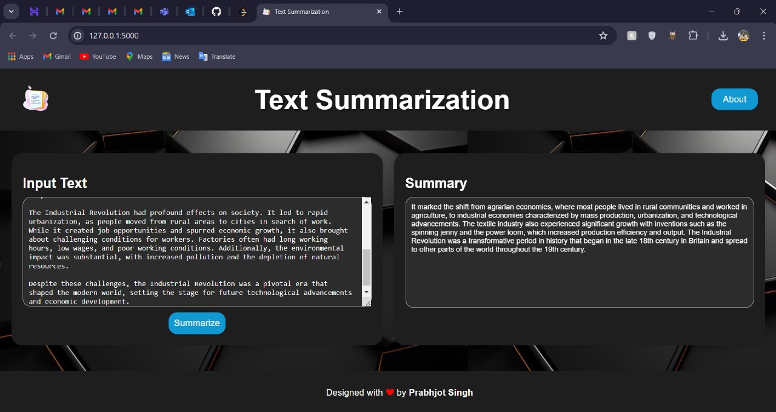
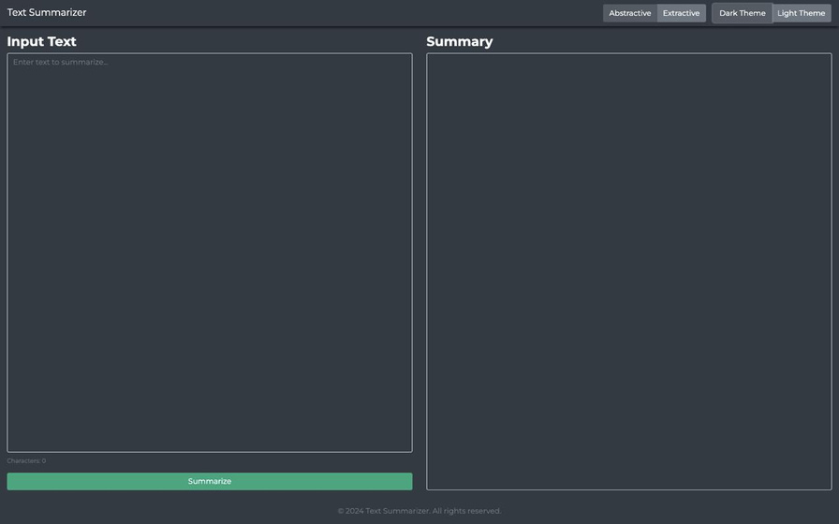
INFERFACE & DEPLOYMENT RESULTS
https://prabhjotschugh-text-summarization.onrender.com/

Slide 23
Conclusion:
Through meticulous implementation of advanced NLP techniques, including abstractive summarization with the T5 model and extractive summarization using spaCy, our journey has showcased remarkable capabilities in generating concise, informative summaries. The T5 model excels in creating nuanced summaries with rephrased content, while spaCy's extractive approach highlights key sentences effectively. These methodologies promise significant advancements in automated content summarization, empowering diverse applications across industries.

Slide 24

&
Any Queries?
Presented by: Group 3

